Slide 1

Developing institutional capacity for attraction of FDI in Ternopil region
Conclusions and Recommendations
Dušan Kulka
Investment Promotion Advisor
July 23, 2018

Slide 2
Structure of the presentation:
Defining the target sectors (for investment promotion)
Identifying potential source countries (and target companies)
Promoting Ternopil region as investment destination
Developing region’s investment infrastructure / industrial sites
Consulting local authorities, experts and other partners

Slide 3
Defining target sectors
TWO TYPES OF TARGET SECTORS:
Priority / important sectors of national / regional economy
Target sectors for active investment promotion
SECTORS IDENTIFIED BY WORLD CAFE:
Agrifood / Food processing
IT
Automotive
Logistics & Storage
Tourism
Clean / alternative energy

Slide 4


Match with national IPO / UkraineInvest
Agrifood / Food processing
IT
Automotive
Logistics & Storage
Tourism
Clean / alternative energy
Agribusiness / Agri-tech
IT
Manufacturing
Aerospace and technology
Infrastructure
Energy / Alternative energy
Fashion

Slide 5
Agri-food / Food processing
Non-cyclical and growing sector
International trade with food & drinks on the rise although many countries and trading blocs apply various protectionist policies
Ukraine traditionally has favorable factor conditions in agriculture and the country is becoming a strong player in agri-food produce and trade
Agriculture is an important sector of Ternopil regional economy
Compared to other sectors, investment and location selection decisions in Agri-food and Food processing are more bound to consumer markets and/or to resources - supplies of inputs (crops, meat, milk, etc.)
Attraction of investment in Agri-food is more complex, requires very good knowledge of the sector and its trends, links to primary producers and pre-processors of crops and regional key players in food processing
Industry’s major players and successful mid-sized companies from neighboring countries potential targets for active investment promotion

Slide 6
Agri-food / Food processing
Recommendations:
Include Agri-food / Food processing in the target sectors for an active investment promotion.
Complete a study of the sector designed to support investment promotion activity: Analyze regional agricultural produce, supply chains and processing capacities & needs in Ternopil and neighboring regions; take into account international trade and trends context.

Slide 7
Information Technology
Very innovative, dynamic and steadily growing sector (estimated 5%+ growth in 2018)
Labor intensive and heavily dependent on educated and highly skilled labor; shortage of tech talents in traditional hubs forces IT companies to rethink their recruitment and business models
Ukraine has the largest and fastest-growing number of IT professionals in Europe. Major concentrations of IT professionals are in large cities (Kyiv, Dnipro, Lviv, Kharkiv, …) however there are 16 IT cluster including one in Ternopil http://www.itcluster.te.ua/
Ukrainian IT sector experiences a strong upward trend, accounts for 3.34% of national GDP with exports reaching USD 3.6 billion in 2017. Most common business model is outsourcing
Given the nature and dynamics of the industry, attracting investment in IT sector is a very special discipline and it is usually done indirectly

Slide 8
Information Technology
Recommendations:
Establish good working relationship with Ternopil IT Cluster and other relevant partners.
Analyze position of regional IT within the Ukrainian IT sector and set the strategy for Ternopil IT Cluster development.
Participate in implementation of the strategy and promote IT through supporting IT related education, infrastructure, collaboration and networking.

Slide 9
Automotive
Very competitive, dynamic sector dominated by hierarchical global production networks / supply chains
Capital intensive industry, strong pressure on continuous innovation and reduction of costs
Europe (EU) maintains position of an important player in terms of both, market for and producer of cars
Significant level of uncertainty related to (possible) technological changes, stricter regulations and changing consumer preferences
Strong presence of automotive sector in neighboring CEE countries including car assembly plants and Tier 1 – 3 suppliers
Ukraine already participates in CEE automotive cluster and most of the automotive FDI is located in Western Ukraine (including Ternopil region)
Relatively simple model of investment attraction: available human resources, ready industrial sites, infrastructure and assistance in site selection and investment project launch

Slide 10
Automotive
Recommendations:
Include Automotive in the target sectors for an active investment promotion.
Prepare market-ready industrial sites / zones / parks in major population centers and the growth poles of the region.
Position Ternopil region as favorable location for suppliers of car parts and components, aim at higher levels of automotive production networks.

Slide 11
Logistics and Storage
The Logistics and Storage sector usually follows needs of its customers or takes advantage of co-locating in proximity to major transportation hubs
Investor in Logistics and Storage usually arrive on their own when one of or both conditions mentioned above are in place
In case Ternopil ODA and RDA want to actively promote the region to logistics and storage companies, prepare a simple overview of the sector including advantages of the location
Relatively simple model of investment attraction: available sites for storage and logistics, infrastructure and assistance in site selection and investment project launch
Investors in Logistics and Storage are often willing to bear or share costs of the preparation of sites including (public) infrastructure

Slide 12
Logistics and Storage
Recommendations:
Include Logistics and Storage in the target sectors for an active investment promotion.
Prepare sites for logistics and warehousing in proximity to major (future) transportation routes and hubs.
Position Ternopil region as favorable location for Logistics and Storage.

Slide 13
Tourism
Tourism and travel sector is one of the world’s largest industries with a solid growth trend and Europe (EU) remains the main destination for international and domestic tourism
Tourism industry in Ukraine recovers after 2014 decline however it still remains on relatively low level
Ternopil region undoubtedly offers a variety of (natural, historical, cultural, religious, …) tourism attractions but the underdeveloped tourism infrastructure and services prevent from better utilization of existing tourism potential
From the business and investment point of view, tourism typically is a “SME industry” driven by local / regional providers of services. Inward / foreign direct investment in tourism usually comes once a critical mass of tourist and visitors has been reached
Private investments in tourism infrastructure are often conditioned by improvements of public infrastructures and related government spending
Attraction of investment in tourism is rather complicated; besides physical conditions (site, infrastructure) external investors want to see the market

Slide 14
Tourism
Recommendations:
Support development of local SMEs / providers of tourism services.
Take an active part in projects aimed at development of tourism in attractive destinations of Ternopil region.
Improve public infrastructure (especially roads) to and in main tourism destination.
Promote Ternopil Oblast as attractive region for tourists and visitors.

Slide 15
Clean / alternative energy
Author of this report lacks sufficient knowledge of the energy sector and can only provide very basic comments and recommendations (assuming most alternative energy projects are photovoltaic power plants)
The approach to investments into photovoltaic power plants presented by representatives of Ternopil ODA was clear and rational – mapping up suitable sites and technical conditions is exactly the information potential investors need
The economic benefits of photovoltaic power plants for municipalities and region are the lowest all sectors discussed by this report
The sites photovoltaic power plants do not require high capacity road access and availability of labor force does not play important role

Slide 16
Clean / alternative energy
Recommendations:
Create a special regime for promoting and servicing investment in alternative energy.
Keep in mind that many investments in photovoltaic power plants are driven by subsidized tariffs and investors tend to behave speculatively.
Do not offer attractive sites close to large population centers and with good road access for photovoltaic power plants.

Slide 17
Visited sites
Ternopil – Mykulinetska
Lanivtsi
Zbarazh
Probizhna
Chortkiv
Ternopil – Airport
Berezhany

Slide 18
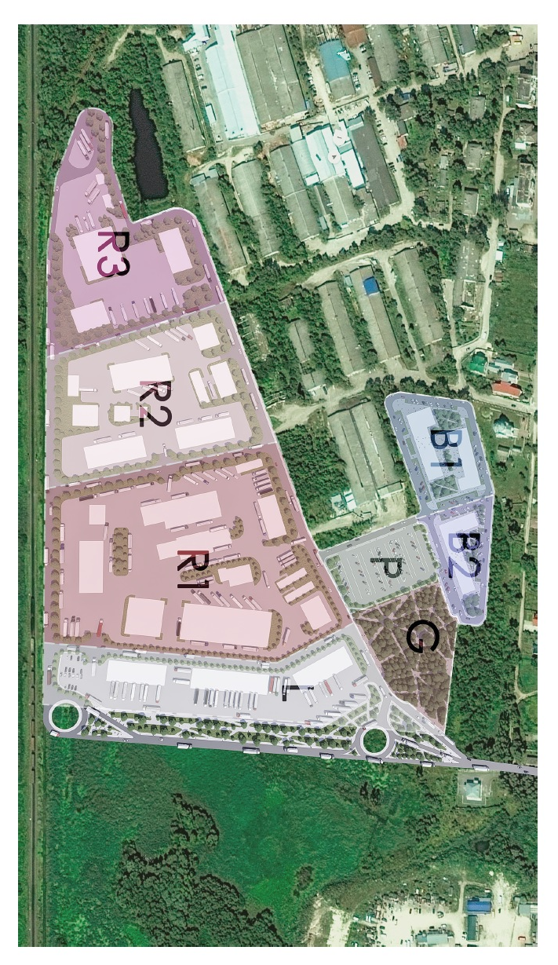
Visited sites
TERNOPIL – MYKULINETSKA
Potentially attractive site
Consider building two access roads
Ground water &Terrain leveling
Total vs. built-up area

Slide 19
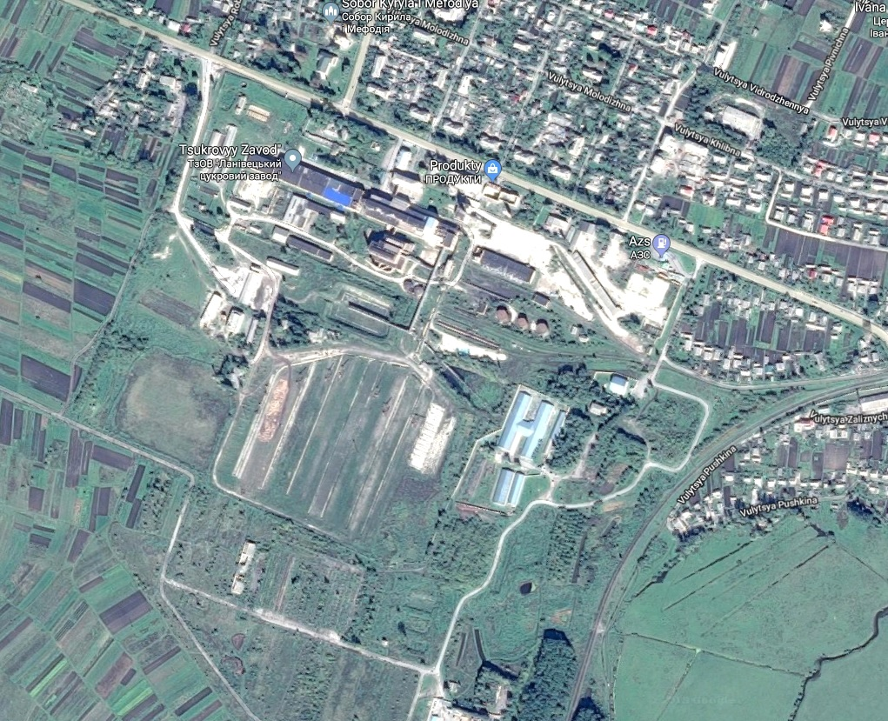
Visited sites
LANIVTSI
Potentially attractive site
Use the two land plots closer to the former sugar factory
Prepare simple concept of the site
Connecting points for utilities
Access road

Slide 20
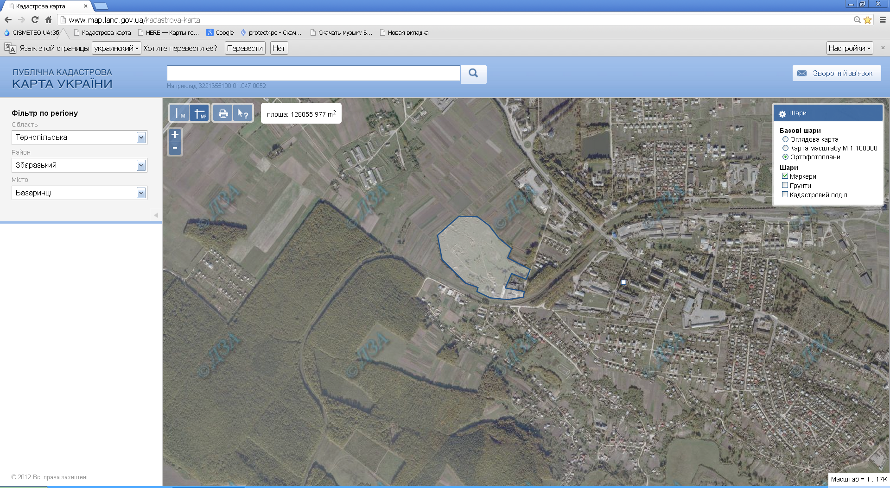
Visited sites
ZALUZHZHYA
Prepare simple concept of the site
Connecting points for utilities
Design direct access from the road Ternopil – Kremenets

Slide 21
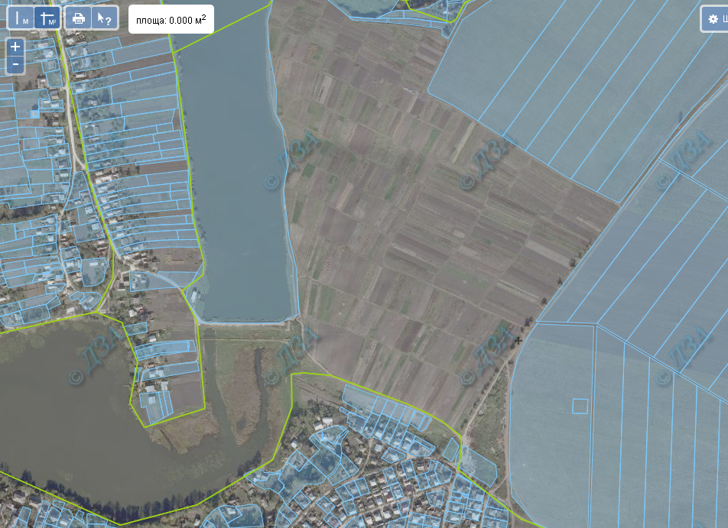
Visited sites
ZBARAZH
Approximately 36 hectares
Agricultural land (?)
Municipal ownership
Area adjacent to the lake sloping
Poor access and insufficient infrastructure
About 1 km north of the castle – industrial development may harm visual conditions
Area for agriculture and/or tourism development
Long-term project

Slide 22
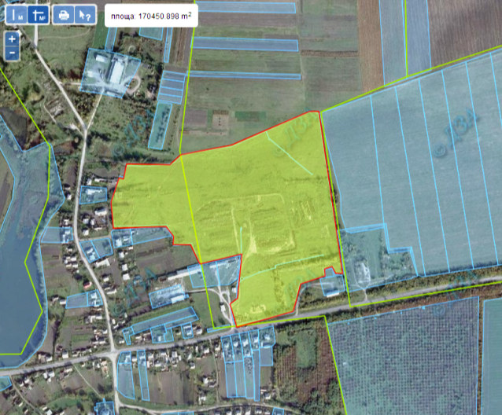
Visited sites
PROBIZHNA
Approximately 17 hectares
Agricultural land
Poor access and insufficient infrastructure
Suitable site for a photovoltaic power station

Slide 23
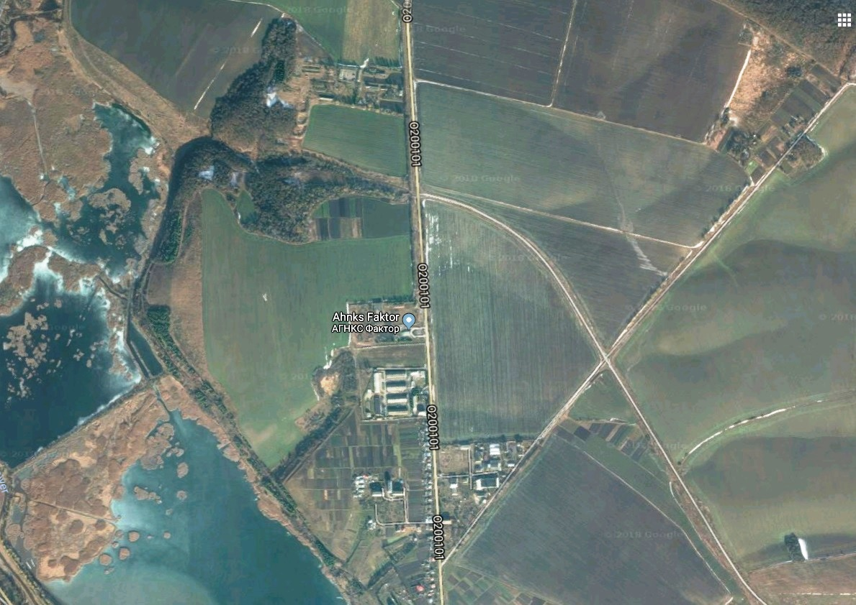
Visited sites
BEREZHANY
Approximately 10+ hectares
Agricultural land
Adjacent to O200101
Relatively flat
Easier access to utilities

Slide 24
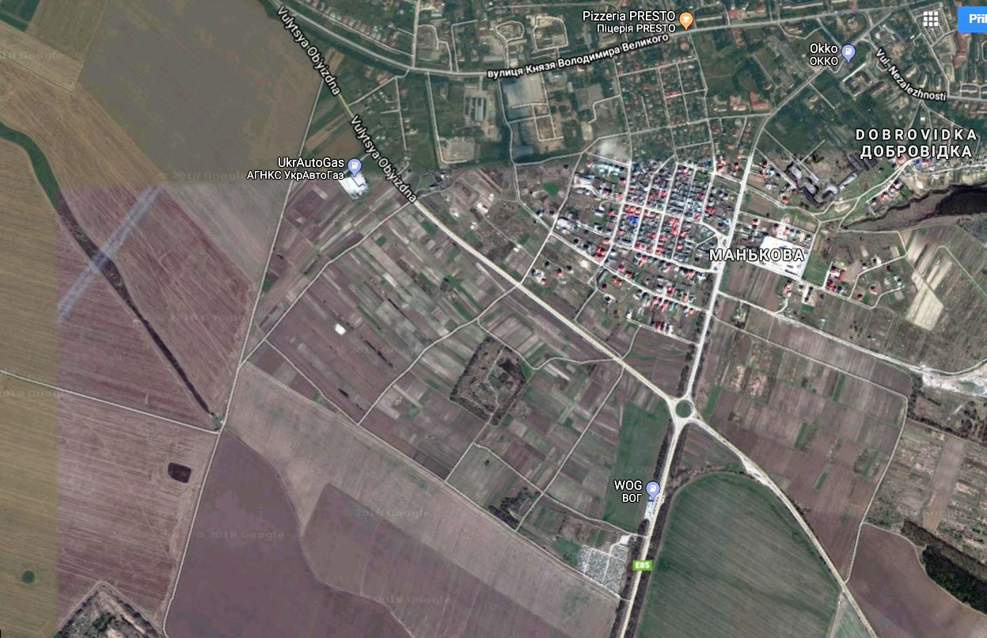
Visited sites
Chortkiv
Approximately100 hectares
Industrial land
Municipal ownership
Relatively flat

Slide 25
THANK YOU!

